Slide 1

Proposal Presentation
DSCI-6011-03
‌Deep Learning

Slide 2

TEAM MEMBERS:
Mustak Ahamed Yadiki
Poojitha Mandapati
Rahulsai Somepalli

Slide 3


‌PROJECT TOPIC:NEURAL MACHINE TRANSLATION

Slide 4
Statement of Project Objectives:
To build a Neural Machine Translation Model which can handle Complex Machine Translations using Deep Learning Models.
Model to be used – Encoder Decoder Recurrent Neural Model
Source Language – French
Output Language – English
Model Validation Metrics – BLEU Score

Slide 5
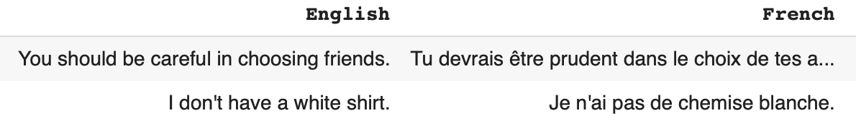
About Data:
Number of sentence present – 190206
Example:

Slide 6
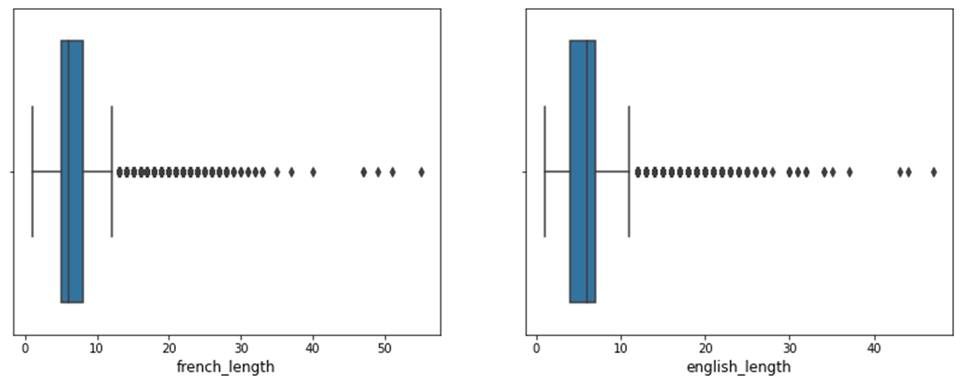
About Data(CNTD).
The sentence length varies between 2 words to 60 words.
From percentile analysis I found out 99.9 percentile number of sentence has only max 22 words.
Selected Max Length - 22

Slide 7
STATEMENT OF VALUE: Why is this project worth doing?
Neural Machine Translation(NMT) revolutionizes language by leveraging advanced neural network architectures to deliver unparalled accuracy and fluency.
By Understanding context, nuances, and idiomatic expressions, NMT systems Provide translations that are not just linguistically precise but also contextually relevant.
The categories are defined by scientist Carolus Linnaeus, who developed a system to define Neural Machine translation according to their common traits.

Slide 8
Review of the state of the art and relevant works:
Purpose:
The purpose of Neural Machine Translation (NMT) is to use deep learning models, to automatically and accurately translate text from one language to another. Here are key purposes and goals of NMT:
Improved Translation Quality:
End-to-End Learning:
Handling Long-Range Dependencies:
Scalability and Generalization:
Multilingual Translation:
Multimodal Translation:
NMT serves as a focal point for research and innovation in the field of machine translation and natural language processing. Ongoing advancements contribute to the development of more efficient and accurate translation models. Overall, the purpose of Neural Machine Translation is to provide an intelligent and automated solution for translating text across languages, addressing the complexities of natural language and enabling effective communication on a global scale.

Slide 9
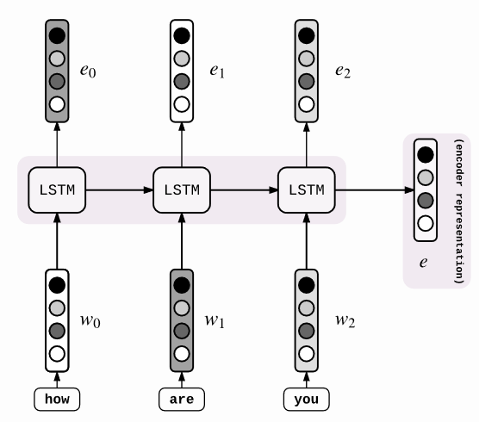
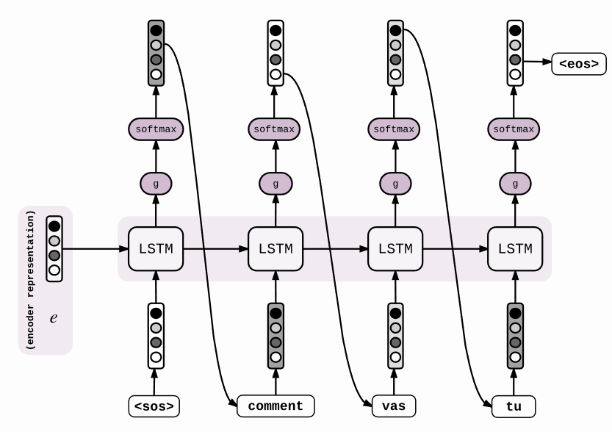
OVERVIEW OF ENCODER DECODER MODEL

Slide 10
Review of the state of the art and relevant works:
Method:
Neural Machine Translation (NMT) involves various methods and techniques to enable accurate and effective translation between languages. Here are key methods used in NMT:
Recurrent Neural Networks (RNNs)
Long Short-Term Memory (LSTM) Networks
Gated Recurrent Units (GRUs)
Transformer Architecture
Attention Mechanisms:
Multimodal Translation
Data Augmentation
These methods are often combined or adapted to address specific challenges and tasks, showcasing the dynamic nature of research and development in the field of Neural Machine Translation.

Slide 11
Approach
To build an neural machine translation , the author mainly establishes a CNN, which belongs to the field of machine learning and deep learning. Pytorch is the programming language.
Data Collection
Data Preprocessing
Model Architecture Design
Data Splitting
Model Traning
Model Evaluation
Deployment

Slide 12
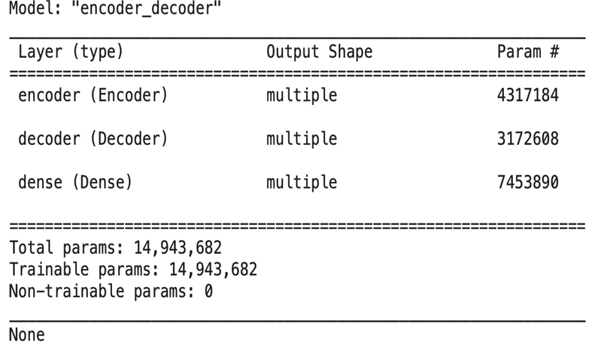
Model Building:
An encoder decoder model is being implemented from scratch written in TensorFlow.
LSTM layer size – 512
Self Trained word embedding size – 128
Batch Size - 1024

Slide 13
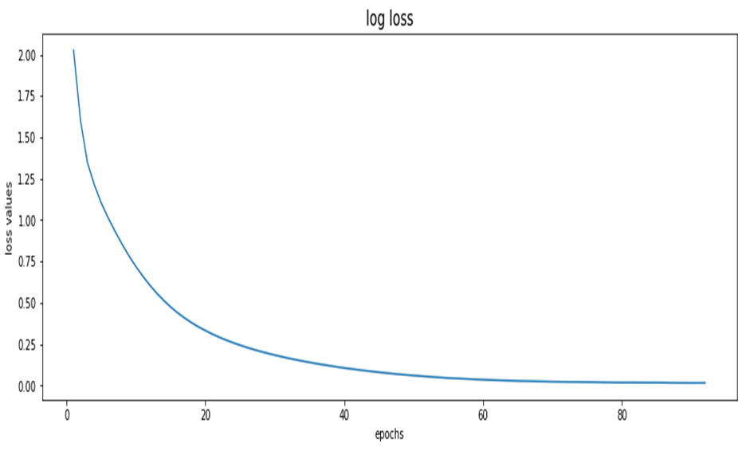
MODEL VALIDATION
The model has been trained for 92 epochs, after that it started overfitting.
Optimal Log Loss – 0.0154
Optimal BLEU Score – 68%

Slide 14

Deliverables:
CNN Model Bulding:
The torch.nn package is used to build a CNN model with two convolution layers and two fully connected layers, setting parameters and weights. The model has 3 input image channels, 6 output channels, . Also, the relu is regarded as a non-linear activaion function to obtain the final model. The model of two fully connected layers is recorded as CNN.
Loss function and optimizer: The application of the loss function is also important in the process of evaluating and optimizing the neural network.
Train the CNN : The test set is trained by applying the above established model and function into the training set for training, and cycling the dataset 10 times to finally get each loss,

Slide 15
Evaluation methodology
Evaluating the success of your project is essential to determine whether the objectives have been achieved.
To check whether the project has met its goals, we will employ the following evaluation methodology and relevant metrics:
Regularly monitor the models performance and consider retraining it with new data to adapt to changes in the dataset over time.
While the dataset is effectively solved, it can be used as the basis for learning and practicing how to develop, evaluate and use convolutional deep learning neural networks for NEURAL MACHINE TRANSLATION.

Slide 16
Conclusion:
In Summary, Model translation is good for short sentences, but can be better in case of sentences having more than 15 words.
Model validation scores can be improved by trying out –
Attention based deep learning models
Neural Transformers for longer sentences.
This Project showcase the power of deep learning and image processing in solving real-world problems by accurately classifying animals based on images and contributing to wildlife conversation.

Slide 17

Professor for giving this golden opportunity

